Slide 1
Programming Language II CSE-215
Prof. Dr. Mohammad Abu Yousuf
yousuf@juniv.edu

Slide 2
Java finally block
Java finally block is a block that is used to execute important code such as closing connection, stream etc.
Java finally block is always executed whether exception is handled or not.
Java finally block follows try or catch block.
Note: If you don't handle exception, before terminating the program, JVM executes finally block(if any).

Slide 3
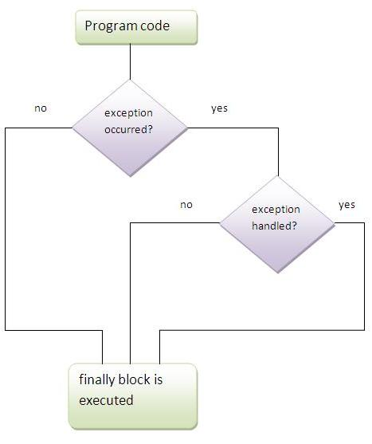
Java finally block

Slide 4
Usage of Java finally
Case 1
Java finally example where exception doesn't occur.
class TestFinallyBlock{
public static void main(String args[]){
try{
int data=25/5;
System.out.println(data);
}
catch(NullPointerException e){System.out.println(e);}
finally{System.out.println("finally block is always executed");} System.out.println("rest of the code...");
}
}
Output:5
finally block is always executed
rest of the code...

Slide 5
Usage of Java finally
Case 2
Java finally example where exception occurs and not handled.
class TestFinallyBlock1{
public static void main(String args[]){
try{
int data=25/0;
System.out.println(data);
}
catch(NullPointerException e){System.out.println(e);}
finally{System.out.println("finally block is always executed");}
System.out.println("rest of the code...");
}
}
Output: finally block is always executed
Exception in thread main java.lang.ArithmeticException:/ by zero

Slide 6
Usage of Java finally
Case 3
Java finally example where exception occurs and handled.
public class TestFinallyBlock2{
public static void main(String args[]){
try{
int data=25/0;
System.out.println(data);
}
catch(ArithmeticException e){System.out.println(e);}
finally{System.out.println("finally block is always executed");}
System.out.println("rest of the code...");
}
}
Output: Exception in thread main java.lang.ArithmeticException:/ by zero
finally block is always executed
rest of the code...

Slide 7
Usage of Java finally
Rule: For each try block there can be zero or more catch blocks, but only one finally block.
Note: The finally block will not be executed if program exits(either by calling System.exit() or by causing a fatal error that causes the process to abort).

Slide 8
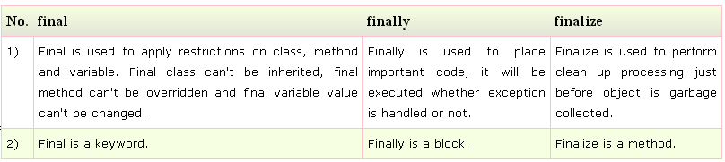
Difference between final, finally and finalize
Differences between final, finally and finalize are given below:

Slide 9
Difference between final, finally and finalize
Java final example
class FinalExample{
public static void main(String[] args){
final int x=100;
x=200;//Compile Time Error
}
}

Slide 10
Difference between final, finally and finalize
Java finally example
class FinallyExample{
public static void main(String[] args){
try{
int x=300;
}catch(Exception e){System.out.println(e);}
finally{System.out.println("finally block is executed");}
}
}

Slide 11
Difference between final, finally and finalize
Java finalize example
class FinalizeExample{
public void finalize(){System.out.println("finalize called");}
public static void main(String[] args){
FinalizeExample f1=new FinalizeExample();
FinalizeExample f2=new FinalizeExample();
f1=null;
f2=null;
System.gc();
}
}

Slide 12
Exception Handling with Method Overriding in Java
There are many rules if we talk about method overriding with exception handling. The Rules are as follows:
If the superclass method does not declare an exception:
If the superclass method does not declare an exception, subclass overridden method cannot declare the checked exception but it can declare unchecked exception.
If the superclass method declares an exception:
If the superclass method declares an exception, subclass overridden method can declare same, subclass exception or no exception but cannot declare parent exception.

Slide 13
Exception Handling with Method Overriding in Java
If the superclass method does not declare an exception
1) Rule: If the superclass method does not declare an exception, subclass overridden method cannot declare the checked exception.
import java.io.*;
class Parent{
void msg(){System.out.println("parent");}
}
class TestExceptionChild extends Parent{
void msg()throws IOException{
System.out.println("TestExceptionChild");
}
public static void main(String args[]){
Parent p=new TestExceptionChild();
p.msg();
}
}
Output:
Compile Time Error

Slide 14
Exception Handling with Method Overriding in Java
If the superclass method does not declare an exception
2) Rule: If the superclass method does not declare an exception, subclass overridden method cannot declare the checked exception but can declare unchecked exception.
import java.io.*;
class Parent{
void msg(){System.out.println("parent");}
}
class TestExceptionChild1 extends Parent{
void msg()throws ArithmeticException{
System.out.println("child");
}
public static void main(String args[]){
Parent p=new TestExceptionChild1();
p.msg();
}
}
Output:
child

Slide 15
Exception Handling with Method Overriding in Java
If the superclass method declares an exception
1) Rule: If the superclass method declares an exception, subclass overridden method can declare same exception, subclass exception or no exception but cannot declare parent exception.
import java.io.*;
class Parent{
void msg()throws ArithmeticException{System.out.println("parent");}
}
class TestExceptionChild2 extends Parent{
void msg()throws Exception{System.out.println("child");}
public static void main(String args[]){
Parent p=new TestExceptionChild2();
try{
p.msg();
}catch(Exception e){}
}
}
Example in case subclass overridden method declares parent exception
Output:
Compile Time Error

Slide 16
Exception Handling with Method Overriding in Java
If the superclass method declares an exception
import java.io.*;
class Parent{
void msg()throws Exception{System.out.println("parent");}
}
class TestExceptionChild3 extends Parent{
void msg()throws Exception{System.out.println("child");}
public static void main(String args[]){
Parent p=new TestExceptionChild3();
try{
p.msg();
}catch(Exception e){}
}
}
Example in case subclass overridden method declares same exception
Output:
child

Slide 17
Exception Handling with Method Overriding in Java
If the superclass method declares an exception
import java.io.*;
class Parent{
void msg()throws Exception{System.out.println("parent");}
}
class TestExceptionChild4 extends Parent{
void msg()throws ArithmeticException{System.out.println("child");}
public static void main(String args[]){
Parent p=new TestExceptionChild4();
try{
p.msg();
}catch(Exception e){}
}
}
Example in case subclass overridden method declares subclass exception
Output:
child

Slide 18
Exception Handling with Method Overriding in Java
If the superclass method declares an exception
import java.io.*;
class Parent{
void msg()throws Exception{System.out.println("parent");}
}
class TestExceptionChild5 extends Parent{
void msg(){System.out.println("child");}
public static void main(String args[]){
Parent p=new TestExceptionChild5();
try{
p.msg();
}catch(Exception e){}
}
}
Example in case subclass overridden method declares no exception
Output:
child

Slide 19
Java Custom Exception
If you are creating your own Exception that is known as custom exception or user-defined exception. Java custom exceptions are used to customize the exception according to user need.
By the help of custom exception, you can have your own exception and message.

Slide 20
How to create a custom exception
Writing your own exception class
Create a new class whose name should end with Exception like ClassNameException. This is a convention to differentiate an exception class from regular ones.
Make the class extends one of the exceptions which are subtypes of the java.lang.Exception class. Generally, a custom exception class always extends directly from the Exception class.
Create a constructor with a String parameter which is the detail message of the exception. In this constructor, simply call the super constructor and pass the message.

Slide 21
// A Class that represents use-defined expception
class MyException extends Exception
{
public MyException(String s)
{ // Call constructor of parent Exception
super(s); }
}
// A Class that uses above MyException
public class Main
{ // Driver Program
public static void main(String args[])
{ try
{ // Throw an object of user defined exception
throw new MyException("GeeksGeeks");
}
catch (MyException ex)
{ System.out.println("Caught");
// Print the message from MyException object
System.out.println(ex.getMessage());
}
}
}
example of java custom exception
Output:
Caught
GeeksGeeks

Slide 22
class InvalidAgeException extends Exception{
InvalidAgeException(String s){
super(s);
}
}
example of java custom exception
class TestCustomException1{
static void validate(int age)throws InvalidAgeException{
if(age<18)
throw new InvalidAgeException("not valid");
else
System.out.println("welcome to vote");
}
public static void main(String args[]){
try{
validate(13);
}catch(Exception m){System.out.println("Exception occured: "+m);}
System.out.println("rest of the code...");
}
}

Slide 23
Output of previous program:
Exception occured: InvalidAgeException:not valid
rest of the code...

Slide 24
What is wrong with following code?
public static void start() throws IOException, RuntimeException{
throw new RuntimeException("Not able to Start");
}
public static void main(String args[]) {
try {
start();
} catch (Exception ex) {
ex.printStackTrace();
} catch (RuntimeException re) {
re.printStackTrace();
}
}

Slide 25
Answer:
This code will throw compiler error on line where RuntimeException variable “re” is written on catch block. since Exception is super class of RuntimeException, all RuntimeException thrown by start() method will be captured by first catch block and code will never reach second catch block and that's the reason compiler will flag error as “exception java.lang.RuntimeExceptionhas already been caught".

Slide 26
What is the problem with below program?
package com.journaldev.exceptions;
import java.io.IOException;
public class TestException4 {
public void start() throws IOException{
}
public void foo() throws NullPointerException{
}
}
class TestException5 extends TestException4{
public void start() throws Exception{
}
public void foo() throws RuntimeException{ }
}

Slide 27
What is the problem with below program?
The above program won’t compile because start() method signature is not same in subclass. To fix this issue, we can either change the method signature in subclass to be exact same as superclass or we can remove throws clause from subclass method as shown below.
public void start(){
}

Slide 28
Thank You

